Slide 1

EWarn System
Speaker Recognition for Attendance

Slide 2
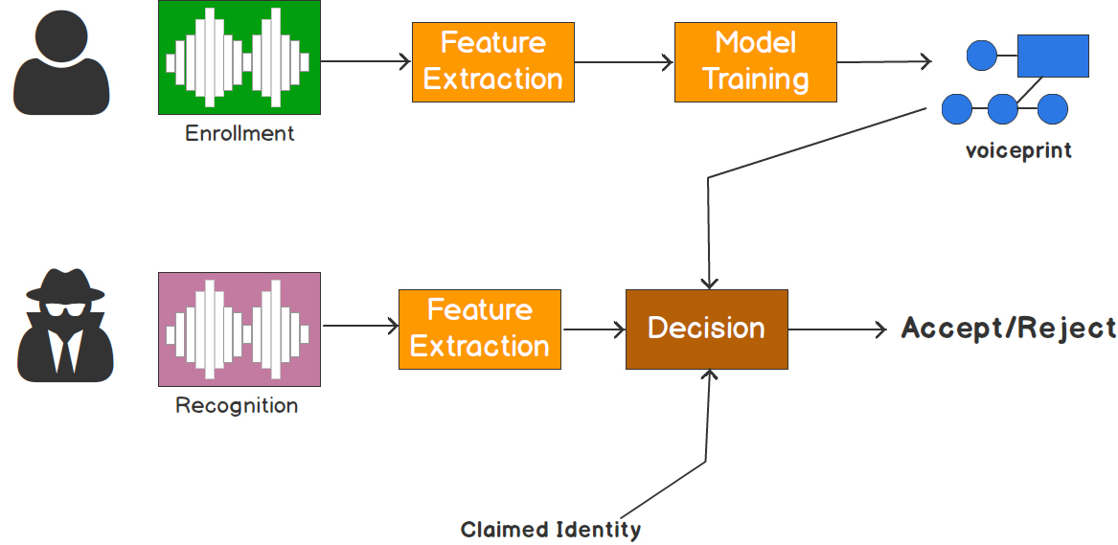
Model used and the process
Step1 : Record Audio
Step2: Compare with dataset
Step3: Returns the speaker with the highest efficiency

Slide 3
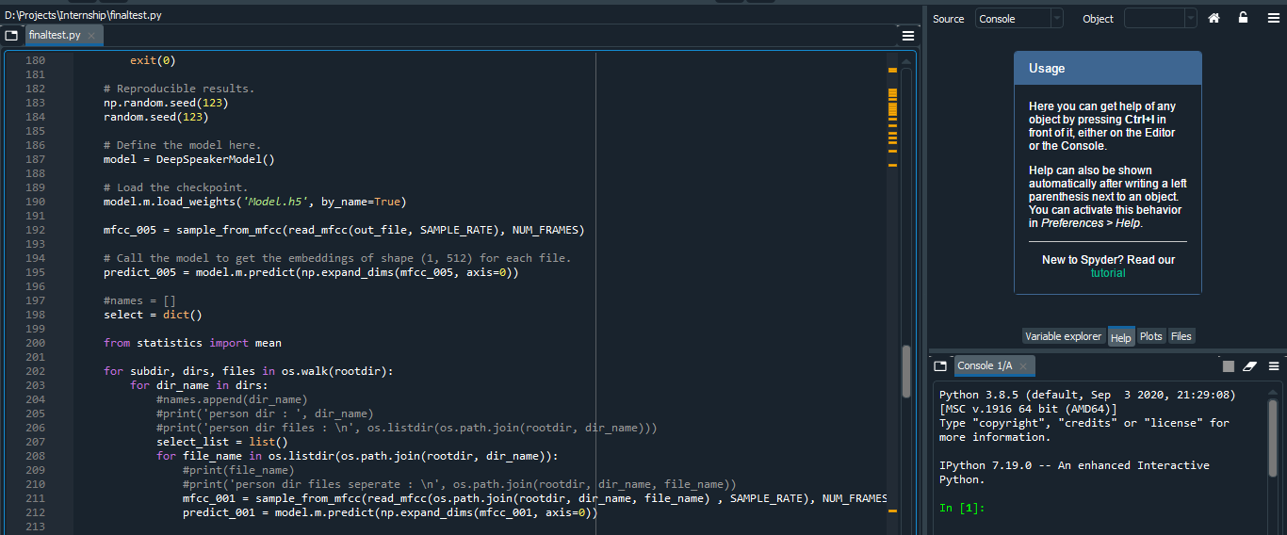
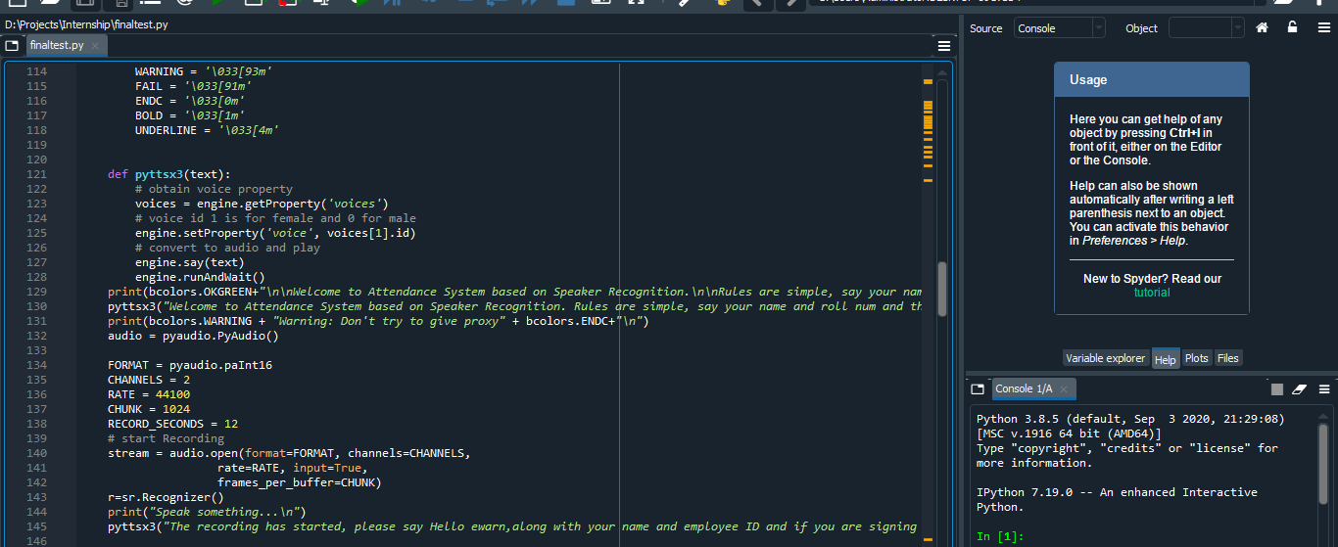
CODE -using spyder

Slide 4
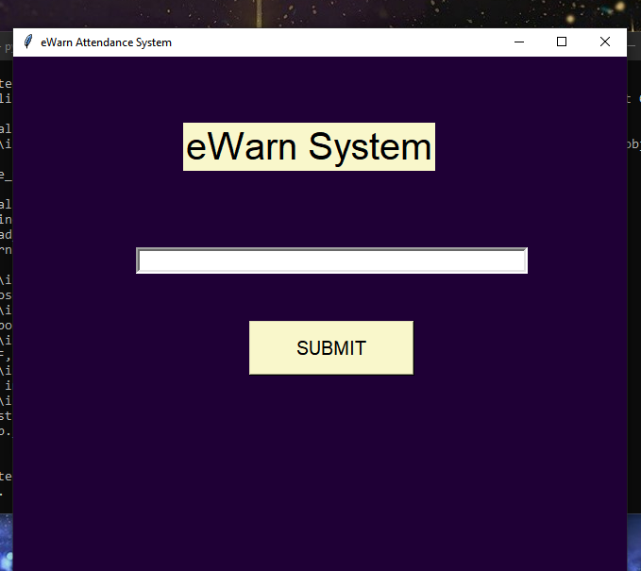
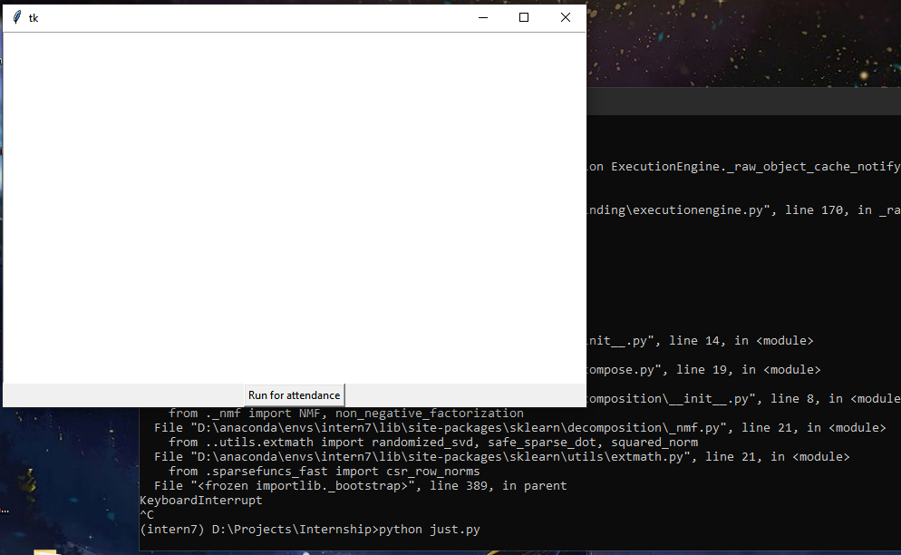
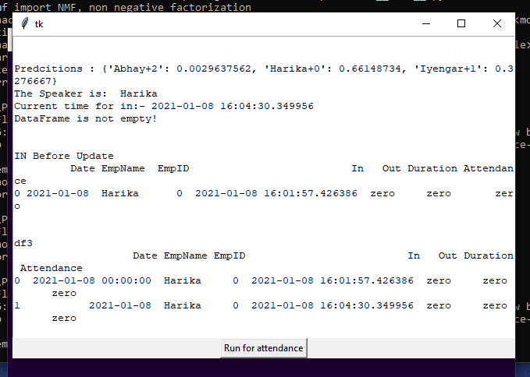
Results
With basic GUI

Slide 5
Advantages
Adaptable for big data.
Efficient system.
Maintains integrity.
Useful in crime detection.

Slide 6
Thank you

